Slide 1

JAVA-POWERED VIRTUAL BANKING: A FUTURISTIC APPROACH.

Slide 2

"PROGRAMMING IS NOT JUST ABOUT WRITING CODE, IT'S ABOUT CREATING SOLUTIONS."
Introduction to JAVA Language : Why should we use JAVA.
Introduction to Virtual Bank Management System.
Java GUI: The Art of User-Friendly Design.
Challenges/Designing in Implementing Virtual Bank Management System In JAVA.
Features of Virtual Bank Management System.
Transaction Processing in Virtual Bank Management System.
Goals and Future Plans of Virtual Bank Management System.
Conclusion.

Slide 3
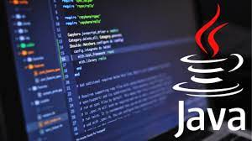

INTRODUCTION TO JAVA LANGUAGE: WHY SHOULD WE USE JAVA?
Java is a widely-used programming language for coding web applications. It has been a popular choice among developers for over two decades, with millions of Java applications in use today. Java is a multi-platform, object-oriented, and network-centric language that can be used as a platform in itself.
Java provides a rich and wide range of API that helps programmers to develop applications. Using Java, we can develop different applications for different purposes. We can use Java technology to develop the following applications: Mobile App Development.
The advanced programmer demands Java language for several tools and a large community. Java language and its technologies are popular because of their support, usability, security, and user-friendly.

Slide 4

INTRODUCTION TO VIRTUAL BANK MANAGEMENT SYSTEM:
A virtual banking system is referred to as a digital platform that enables users to conduct financial transactions and gain access to financial services over the Internet. It is a creative approach that seeks to increase consumer comfort, speed, and security while simultaneously enhancing the effectiveness and lowering the cost of banking operations.
The virtual banking system project in Java is an innovative solution that provides a seamless banking experience for customers while improving the efficiency and cost-effectiveness of banking operations.
The studies have also highlighted the importance of security features in virtual banking systems. The literature review provides a valuable resource for anyone interested in designing and developing a virtual banking system should go for Java.

Slide 5
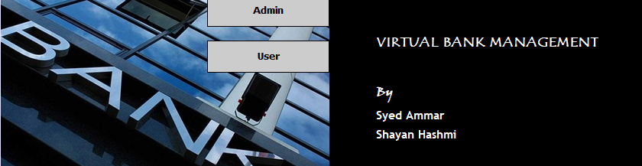
Graphical User Interface (GUI) is an important aspect of any software application that allows users to interact with the application using a graphical interface. Java provides an extensive set of libraries and frameworks for building GUI-based applications.
GUI in JAVA comprises graphical units like buttons, labels, windows, etc. Via which users can connect with an application. Swing and JavaFX are two commonly used applications to create GUIs in Java.
Java's GUI components include labels, text fields, text areas, buttons, pop-up menus, etc. GUIs can help to simplify complex banking processes and improve the overall efficiency of bank operations.
Its goal is to present the user with decision points that are easy to find, understand and use. In other words, GUI lets you control your device with a mouse, pen, or even your finger.
JAVA GUI (THE ART OF USER-FRIENDLY DESIGN):

Slide 6
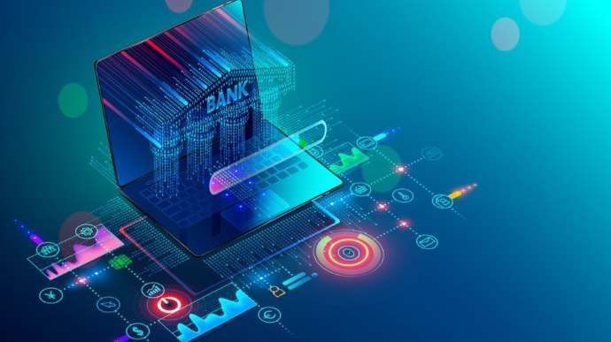
CHALLENGES/DESIGNING IN IMPLEMENTING A VIRTUAL BANK MANAGEMENT SYSTEM IN JAVA:
User Interface: The user interface of a virtual bank management system should be user-friendly, intuitive, and easy to use. You should design the interface to make it easy for customers to access their accounts, view their transactions, and perform other tasks.
Security: For security majors, the system requires the user to enter their login credentials to access their account. This ensures that only authorized users can access their accounts. The system uses access control techniques to prevent unauthorized access to sensitive areas of the system. The system restricts access to certain features and data to only authorized users, based on their roles and permissions. However, the admin of the bank can see all money transaction histories of users, loan applications, cheque books requests of users.
Testing: After implementation, the virtual banking system should be tested to ensure that it meets the requirements and functions correctly. This includes unit testing to ensure that each module and component works as expected and interacts correctly with other modules.

Slide 7
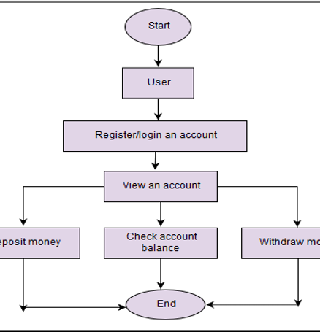
FEATURES OF VIRTUAL BANK MANAGEMENT SYSTEM IN JAVA:
User/Admin registration and login. Customers should be able to create an account, login securely and perform transactions.
1
Account management: Customers should be able to view their account details, balance, transaction history, and manage their accounts, including opening and closing accounts.
Account management: Customers should be able to view their account details, balance, transaction history, and manage their accounts, including opening and closing accounts.
Improved efficiency: Virtual banking systems can streamline banking operations and reduce the time required to complete transactions.
Cost savings: Virtual banking systems can reduce operational costs by automating processes, reducing paperwork, and minimizing the need for physical branches.

Slide 8

TRANSACTION PROCESSING IN BANK MANAGEMENT SYSTEM IN JAVA:
Transaction processing in a bank management system involves several tasks, such as recording transactions, updating account balances, etc. Here's an overview of how transaction processing can be implemented in a bank management system using Java:
Create a class to represent a bank account, with attributes such as account number, account holder name, and balance. Create a database to store account information, such as account numbers and balances. Create a user interface to allow users to interact with the system, such as entering transaction details and generating reports. Implement the transaction processing logic, which involves the following steps:
Validate the transaction details, such as the account number and transaction amount.
Retrieve the account balance from the database.
Calculate the new balance after the transaction is completed.
Update the account balance in the database. Record the transaction in a transaction log.
Overall, transaction processing in a bank management system requires careful planning, implementation, and testing, JAVA provides a robust platform for developing such systems due to its rich library of classes, support for multi-threading, and cross-platform compatibility.

Slide 9

GOALS AND FUTURE PLANS OF VIRTUAL BANK MANAGEMENT SYSTEM:
The goal of a virtual banking management system is to provide customers with a secure and convenient way to access their bank accounts and conduct financial transactions from anywhere and at any time.
Through online banking, people can submit debt consolidation loans for approval and set up automatic deductions to repay the loans. For example, a home loan plays a major role when buying a house.
Enhanced security: As cyber threats continue to evolve, virtual banking systems will need to improve their security measures to prevent fraud and protect customers' personal and financial information.
Integration with other financial services: Virtual banking systems are likely to integrate with other financial services such as investment management, insurance, and payment processing to provide a seamless experience for customers.
Personalized banking: With the help of artificial intelligence and machine learning, virtual banking systems can offer personalized banking services that are tailored to individual customers' needs and preferences.
Greater accessibility: Virtual banking systems will continue to expand their reach and become more accessible to people in remote areas, low-income households, and those with disabilities.
Overall, virtual banking management systems will continue to evolve and adapt to the changing needs and expectations of customers, providing them with a more convenient, secure, and personalized banking experience.

Slide 10

CONCLUSION:
In conclusion, a virtual banking management system has the potential to contribute to several Sustainable Development Goals (SDGs) such as SDG 8 (Decent Work and Economic Growth), SDG 9 (Industry, Innovation and Infrastructure), and SDG 10 (Reduced Inequalities).
By providing secure and convenient access to financial services, virtual banking systems can promote financial inclusion, especially for underserved and marginalized communities. This can help reduce inequalities and improve economic growth and productivity.
Moreover, virtual banking systems can also promote innovation and technological advancements in the financial sector, leading to more efficient and effective financial services that can support economic growth.
Overall, virtual banking management systems, implemented using programming languages such as Java, have the potential to contribute to sustainable development by promoting financial inclusion, innovation, and economic growth.

